Slide 1

Intro to Git & GitHub
By Sean O’Mahoney

Slide 2
Content
Git vs GitHub
What is GitHub
Setting up Git
Using Git
Sign-up to GitHub
Git -> GitHub
Rinse & Repeat
Branching
Forking
PR (Pull Requests)
Hacktoberfest
Other
Manchester Hacktoberfest by PyDataMCR, PyLadiesNW, and HER+Data
Student Developer Pack - GitHub Education
Resources & Useful Links

Slide 3
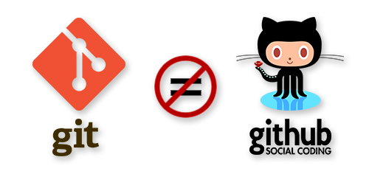
Git vs GitHub
Git is just version control
But is a distributed version control system
Meaning you can push/pull from other peoples machines
GitHub is a host for repo’s
But has many more features
It allows vast collaboration
Also provides a visual interface

Slide 4
What? (GitHub)
“Founded in 2007, GitHub has brought millions of developers together to discover, share, and build better software.” – GitHub
Collaboration
Version Control
Submit issues & comment
Web & Visual Desktop interface
GitHub Pages (Free Website Hosting)

Slide 5
Setting up Git
From your Start Menu locate Git and open Git CMD (Bash should be fine as well)
This will open up a new terminal window in your “H:” Drive
Create a new file by running “mkdir [file_name]”
To navigate to this new folder, run “cd [file_name]”
Now we’re in the new folder we can start using Git

Slide 6

Using Git
To create a new repository where we are, we’ll run “git init”
1
Now we can create files and modify them, but to add them to git, we run “git add *”
2
To stage a change, to add a point in time, we run: git commit -m "Commit message“
3
If we’ve made any mistakes and wish to go back a commit, we can run “git revert”
4

Slide 7
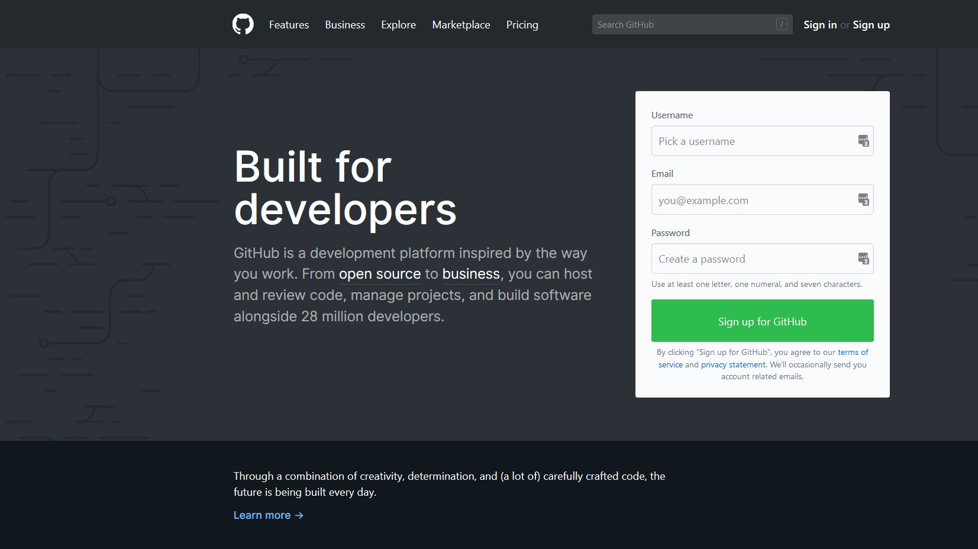
Sign-up to GitHub
Now we’ll push our repo’ to a remote server, GitHub, meaning we’ll need an account

Slide 8
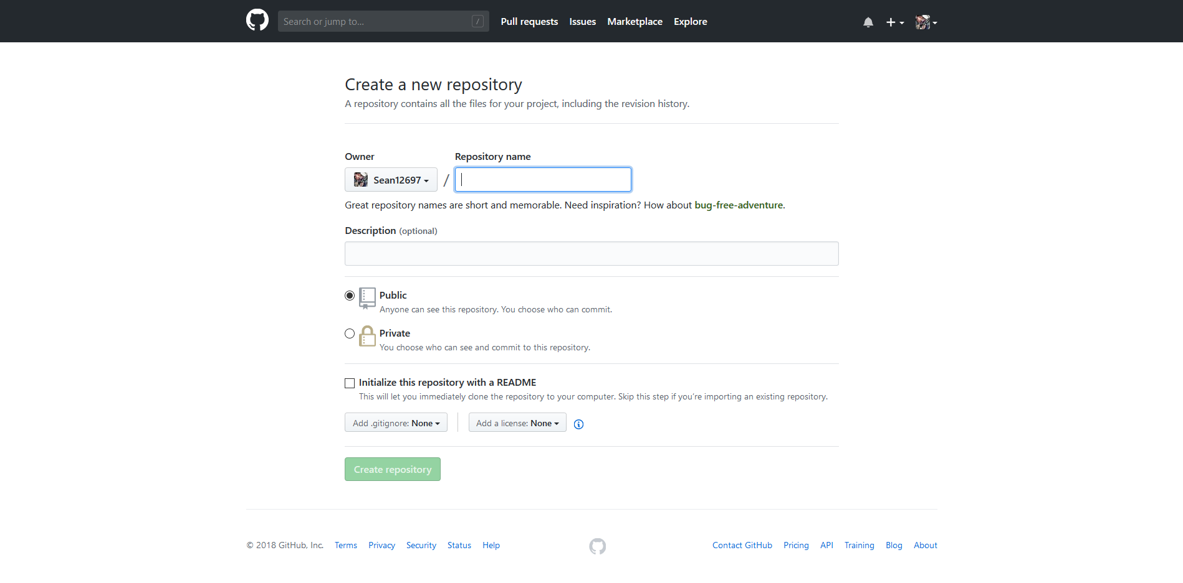

Slide 9
Git -> GitHub
Now we have created a new repo’ on GitHub to use, but we have our own so we’ll use it
By running “git remote add origin git@github.com:[user]/[repo].git” we’ll connect it
It might ask you to sign in, especially if you had the HTTPS option selected (and not SSH)
Then to push our local files from Git, we’ll run “git push -u origin master”

Slide 10
Rinse & Repeat (for Simple Projects)
If you add any new files to the project, run “git add [filename]” or “git add *”
To commit any changes, run: git commit -m "Commit message“
Then to push back up to GitHub, run: “git push” or “git push origin master”
If we make changes on another machine, the GitHub Website or are unsure anyone has made any changes to the master branch, we can run “git pull” to pull any changed/added files to the repo’

Slide 11
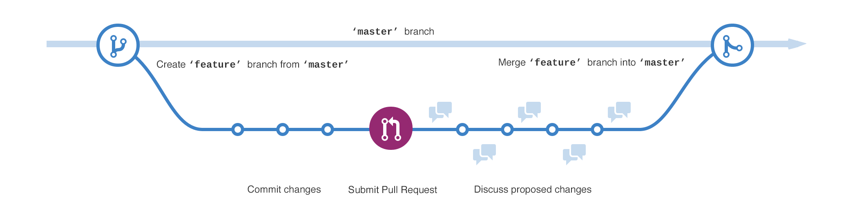
Branching
Branches are essentially a copy of a point in time of your repo, then worked on separately, we have referred to “master” before, and this is the main branch you create and work on.
But lets say you want to test code out before making it live on the master branch, or someone else wants to use your project, either modifying it for their needs or adding more, then we’d have a branch of the repo’
To create a new branch of our own repo’, we can run: “git branch [branch-name]”
From there we can work on it like we have been doing prior
To switch back to our master branch or another, we can run: “git checkout [branch-name]”
Then finally to merge the changes, we run: “git merge [branch]”

Slide 12
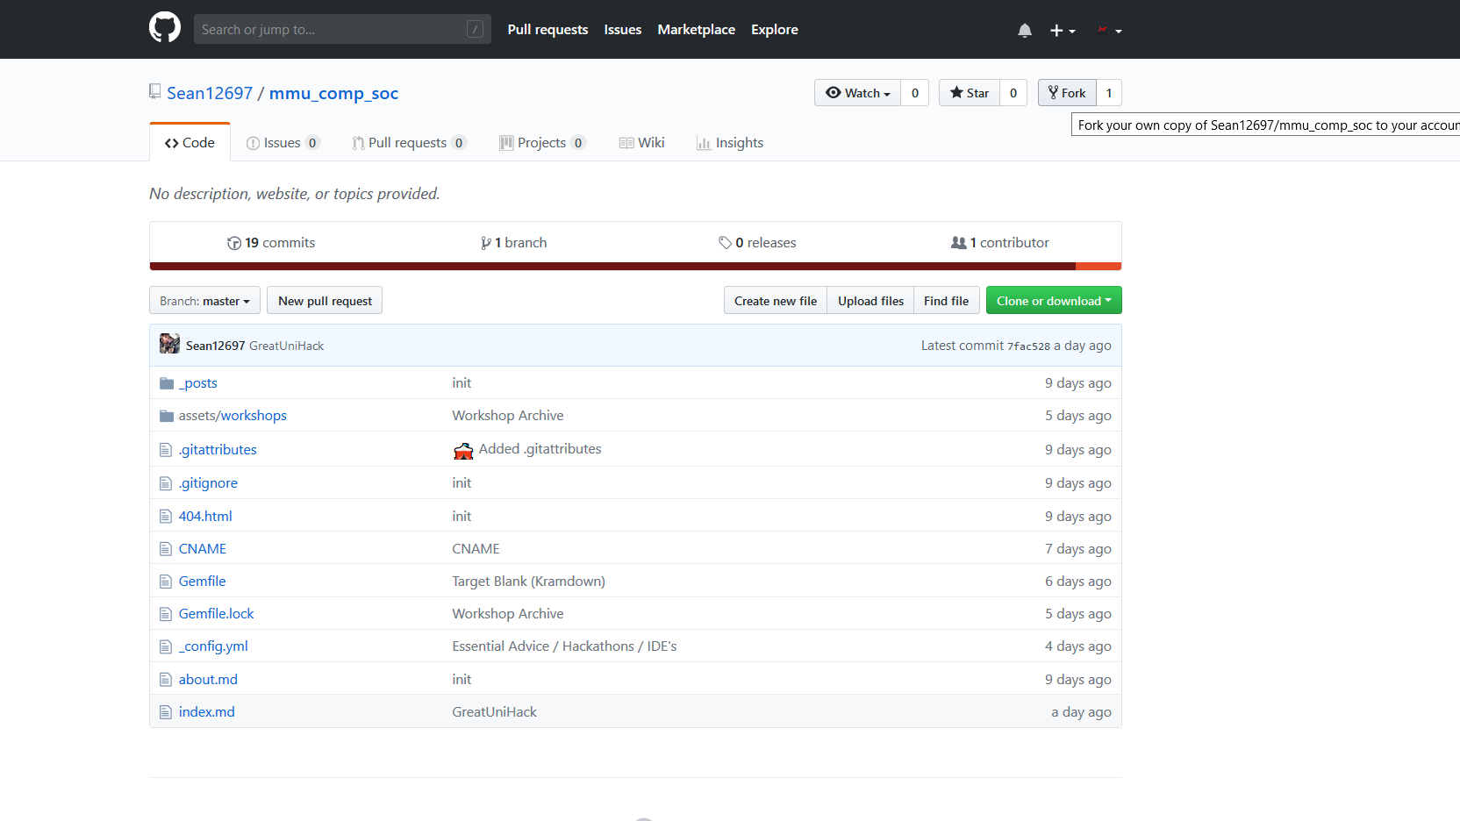
Forking (Cloning in Git)
This is the action made creating a new branch, but is used to refer to when you “fork”/clone someone else's repo’ (which you will likely not have permission to commit changes to)
To clone someone's public repo’ on Git, it’s as simple as running: “git clone [url]”
Although this can also be done completely via the GitHub web interface

Slide 13
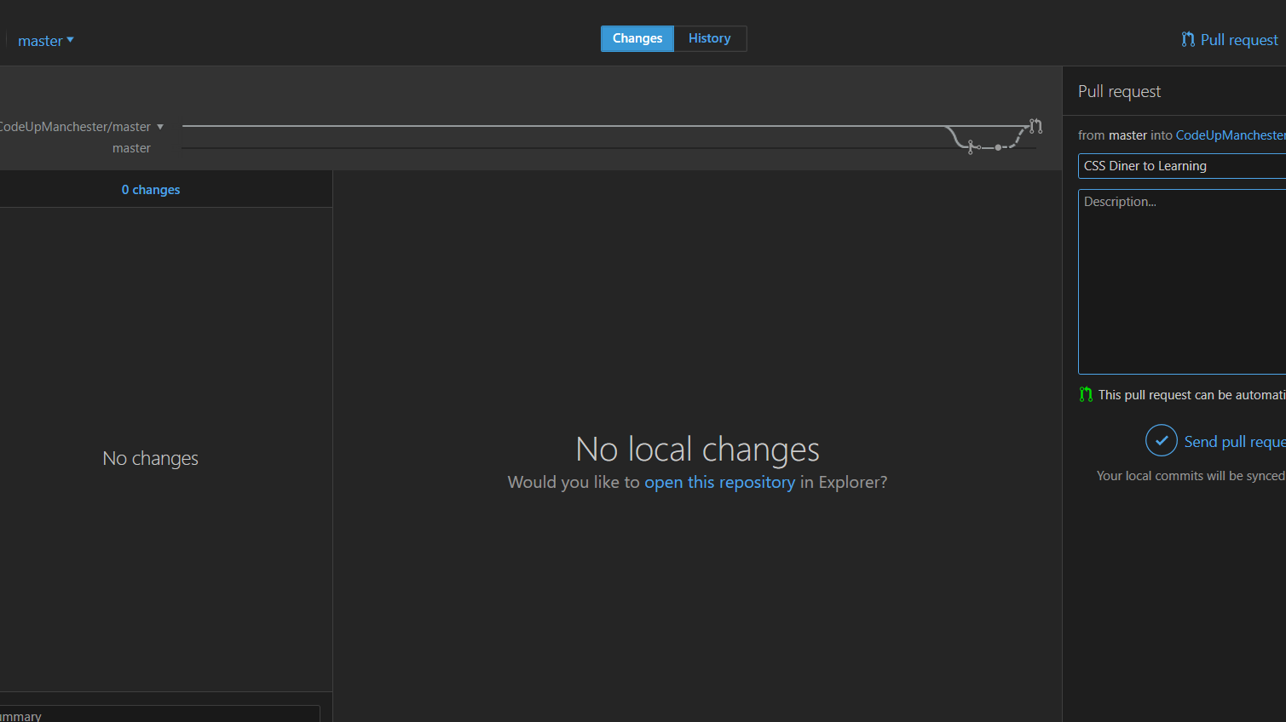
PR (Pull Requests)
This is similar to merging a branch of our own, but is usually done after forking someone else's repo’ and you wish to merge changes (although can be done between branches of your own)
You can make a PR via both the desktop and web interface quite simply like shown in the background

Slide 14

Hacktoberfest (5 PR’s in October)
Free T-Shirt and Stickers… Whoop!!!

Slide 15
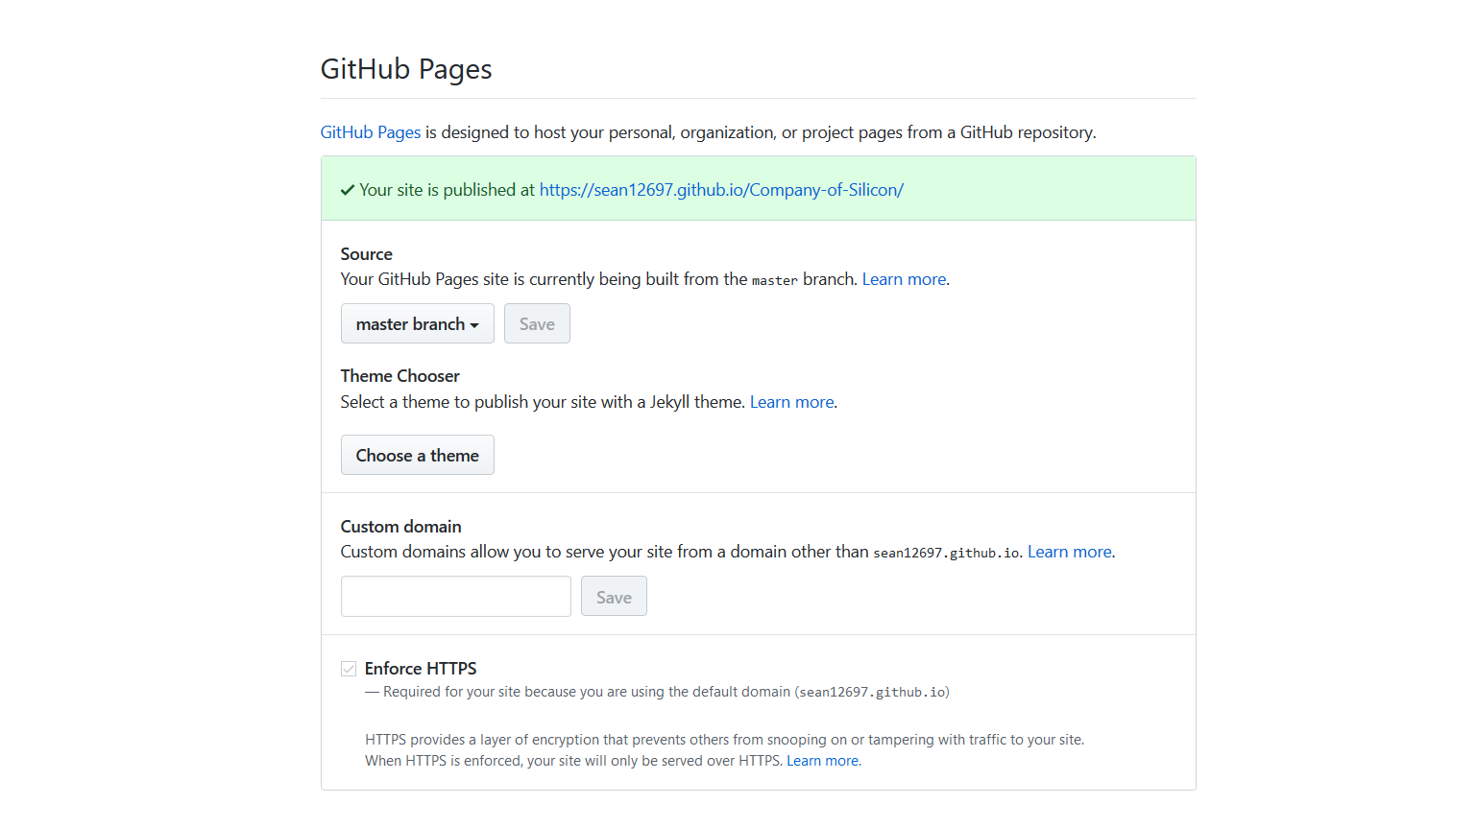
Other
If you want to host a simple website and have an address, GitHub will offer that in the “GitHub Pages” section of a repo’s settings
You can also build a Jekyll site this way, which there will be a workshop on, on the 17th October 2018 - https://www.eventbrite.co.uk/e/intro-to-jekyll-tickets-50932462366

Slide 16
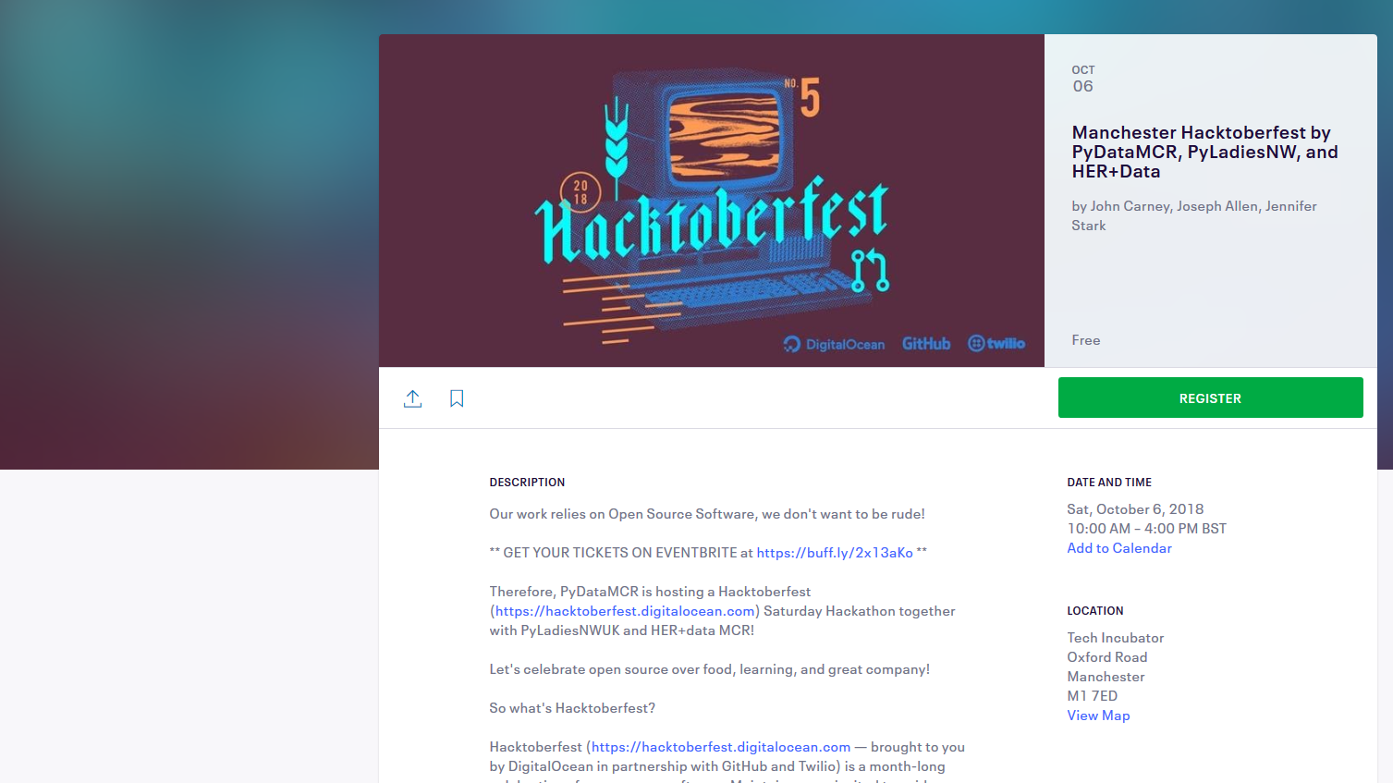
Hacktoberfest Event – 6th Oct ‘18
[10:00] - Welcome/Intro to Hacktoberfest [10:15] - Introduction to OpenSource: open source 101 and using GitHub to collaborate [10:30] - Break out room: Sign up to Hacktoberfest / GitHub [10:45] - Hack / Tutorial: how to contribute to open source projects [12:45] - Lunch [12:45] - Hack [15:30] - Closing and demos [16:00] - Hatch for food and drinks
https://www.eventbrite.co.uk/e/manchester-hacktoberfest-by-pydatamcr-pyladiesnw-and-herdata-tickets-50085693658

Slide 17
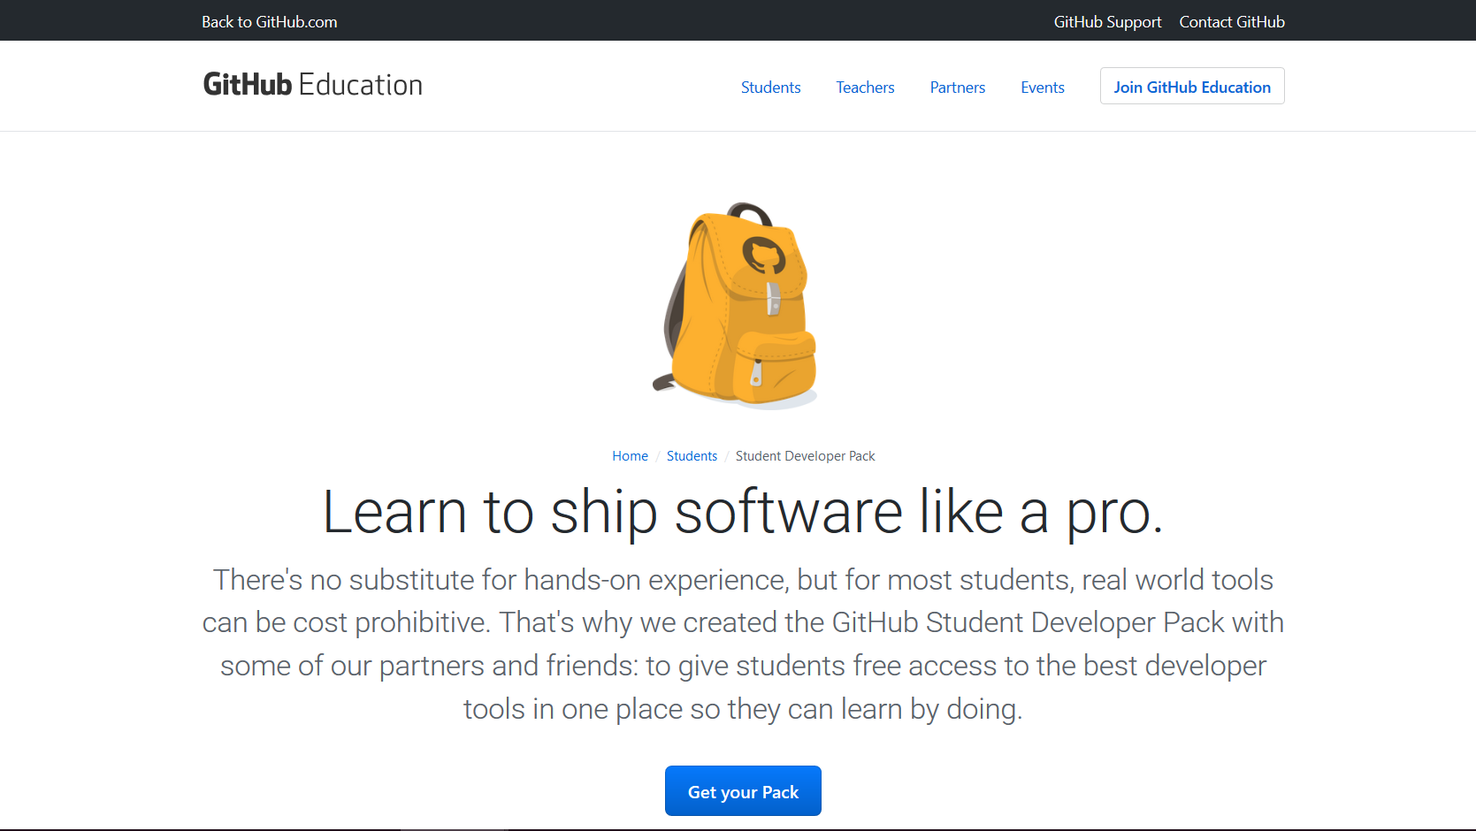
Student Developer Pack - GitHub Education
Atom — atom.io A hackable text editor for the 21st Century Open Source by GitHub, free for everyone
Bitnami — bitnami.com Install cloud applications in a single click Business 3 plan (normally $49/month) for one year
DigitalOcean — digitalocean.com Simple cloud hosting, built for developers $100 in platform credit for new users
DNSimple — dnsimple.com Simple DNS management with one-click services and a robust API Bronze hosted DNS plan (normally $3/month) for two years
Figure Eight — figure-eight.com Data enrichment platform Access to the Figure Eight platform (normally $2,500/month) and $50 in worker credit
GitHub — github.com Powerful collaboration, code review, and code management Micro account (normally $7/month) with five private repositories while you’re a student
HackHands — hackhands.com Live programming help available 24/7 $25 in platform credit
Namecheap — namecheap.com Domain name registration and SSL certificates One year free domain name registration on the .me TLD (normally 8.99/year) and one year free SSL certificate (normally $9/year)
Orchestrate — orchestrate.io Database API that includes search, time-series events, geolocation and graph queries Developer account (normally $49/month) while you’re a student
Screenhero — screenhero.com Screen sharing for collaboration in teams Individual account (normally $9.99/month) while you’re a student
SendGrid — sendgrid.com Email infrastructure as a service Student plan (normally $4.95/month) for one year
Stripe — stripe.com Web and mobile payments, built for developers Waived transaction fees on first $1,000 in revenue processed
Travis CI — travis-ci.com Continuous integration platform for open source and private projects Private builds (normally $69/month) while you’re a student
Unreal Engine — unrealengine.com A complete suite of game development tools made by game developers, for game developers Unreal Engine (normally $19/month) while you’re a student
Examples from 2014: https://blog.github.com/2014-10-07-the-best-developer-tools-now-free-for-students/

Slide 18
Resources & Useful Links
Intro to Git (used): http://rogerdudler.github.io/git-guide/
Pro Git book (free): https://git-scm.com/book/en/v2
Student Developer Pack: https://education.github.com/pack
Hacktoberfest: http://hacktoberfest.digitalocean.com/
Manchester Hacktoberfest by PyDataMCR, PyLadiesNW, and HER+Data: https://www.eventbrite.co.uk/e/manchester-hacktoberfest-by-pydatamcr-pyladiesnw-and-herdata-tickets-50085693658
MMU Computing Society Website: http://mmucompsoc.com/

